Slide 1
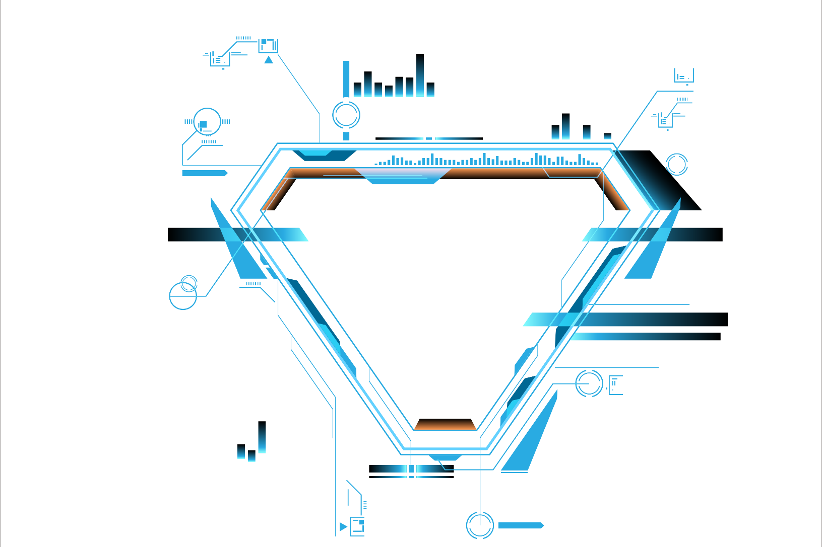

MerryFairy
MerryFairy
MerryFairy
A planting game which will finally turned out to be crypto fairies.
119010068
119010176

Slide 2
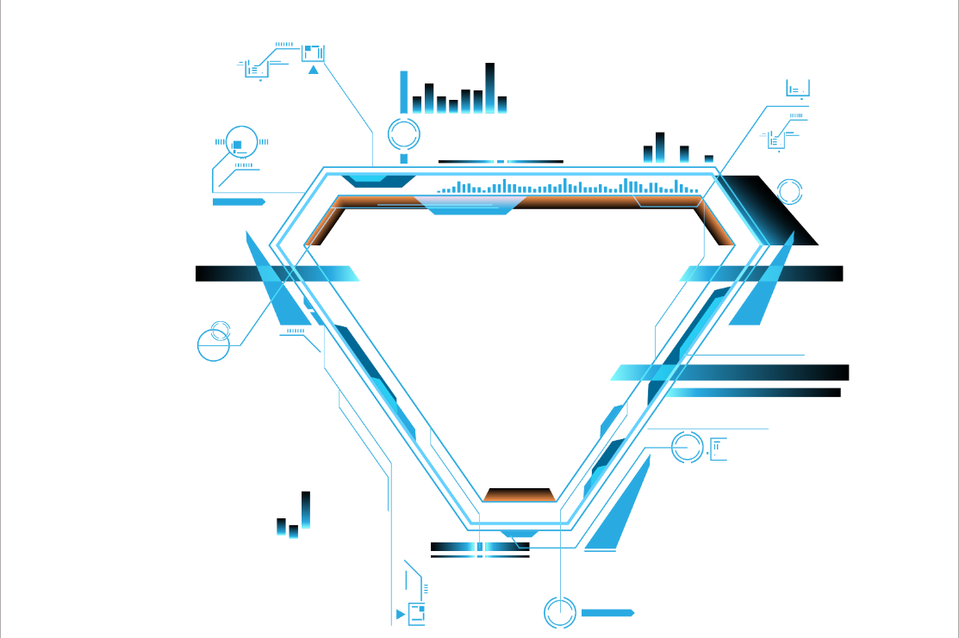
Game Fi
How users can participate
CONTENT
Implementation
What is needed to implement
Improvement
A better future
Demo
A simple demo

Slide 3
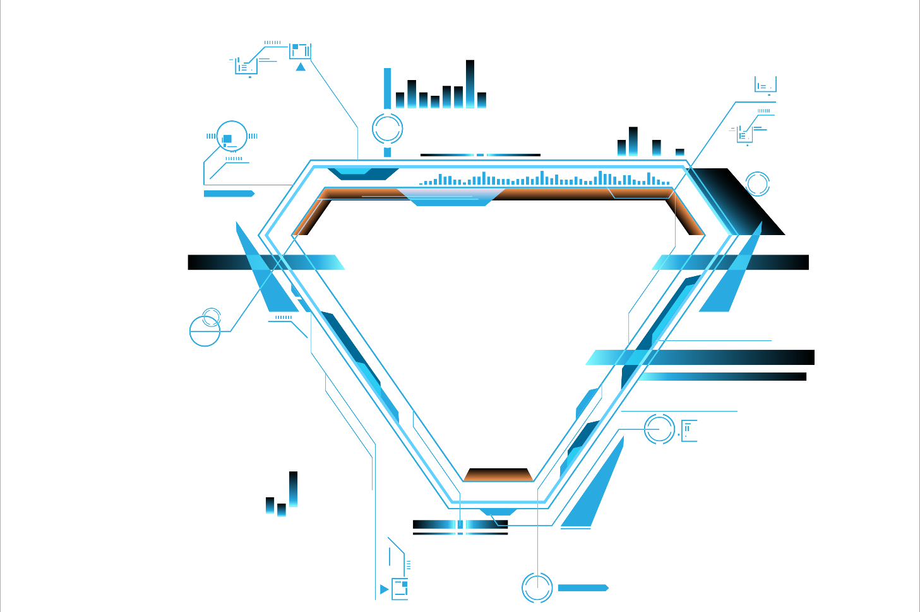
Game Fi
Game Fi
Game Fi

Slide 4

Game Fi
Egg
Wallet
Account
Fairy Bean
Wallet
Connect
Assign
Buy
Produce
Grow
Production
NFTs: ERC-721
Key

Slide 5
Game Fi
Egg
Price
Fairy Bean
Buy
Mint
Time
Produce
Grow
Production

Slide 6



Game Fi
Egg
Wallet
Account
Fairy Bean
Wallet
Connect
Assign
Buy
Produce
Grow
Production
Generate
Mint
NFTs: ERC-721
Key

Slide 7
Eggs
Production: 70 beans
Rarity: High
Time: 1 week
Production: 60 beans
Rarity: Plain
Time: 3 days
Production: 50 beans
Rarity: Low
Time: 1 day
Slow
Medium
Fast

Slide 8
Implementation
Implementation
Implementation

Slide 9
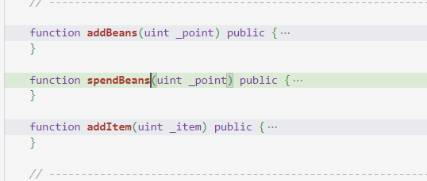
Implementation
40
75
100
Mint NFT
Front-end
Collaboration
standard: ERC-721.
fairy beans: non ERC-20
React+truffle

Slide 10







Useful Tools
Comprehensive suite for contract development
local testNet
IPFS

Slide 11
Demo
Demo
Demo

Slide 12
Improvement
Improvement
Improvement

Slide 13
Future Works
Wonder Shop
More fancy snacks ot other items to interact with the fairies
Users can buy weapons, defense, etc. in order to win in the battle.
PvP Games
Mutant Fairies
There will be mutant syrup available in the shop, and thus be able to mint mutant fairies.

Slide 14
Q & A
Q & A
Q & A

